Slide 1
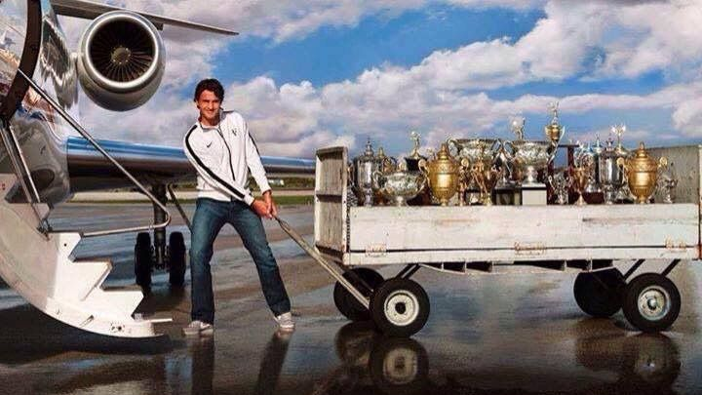
The tale of Roger Federer
Micha Panagiotidi
MSc Data Science
LSE
Notes:
I love tennis!
I have been following Federer for many years now and wanted to use my knowledge of data to understand his game better.
----------------
Tennis and Federer are great passions of mine.
He is currently 37 years old and ranked number 4 in the world.
Federer is an active legend of the sport, recently making the news for achieving his 100th title in his 22nd year in tennis.
Only the second man in tennis history to achieve this.
1

Slide 2
Use of Data
Managing & Visualising Data Project
How did he manage to stay at the top?
Model his winning probabilities
Notes:
As information is becoming more easily available, sports is being viewed differently.
I want to use that data to find out more about Federer’s playing style.
How did you manage to stay active for this long? Did he adjust in his game?
2

Slide 3
Use of Data
Managing & Visualising Data Project
How did he manage to stay at the top?
Model his winning probabilities
Can he keep winning?
Notes:
As information is becoming more easily available, sports is being viewed differently.
I want to use that data to find out more about Federer’s playing style.
How did you manage to stay active for this long? Did he adjust in his game?
2

Slide 4
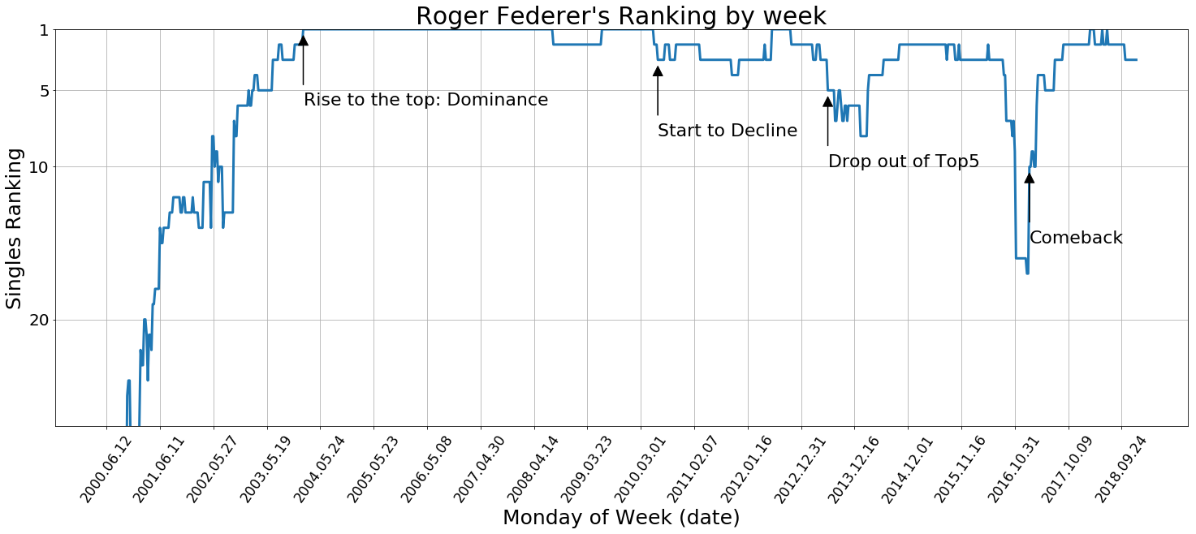
Ranking History
Notes:
To give you a bit of flavour of Federer’s career.
He turned pro in 1998, about 3 years later he reached the top 20 and at
4

Slide 5
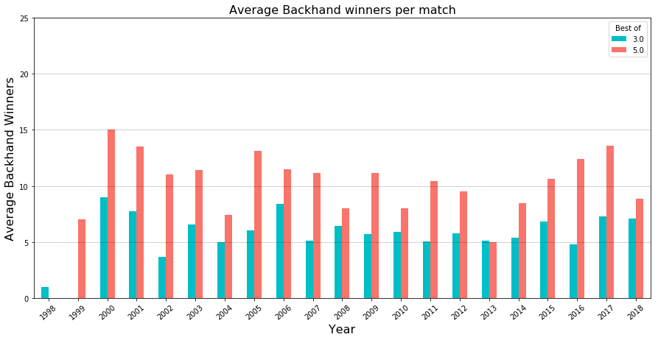
The Data: How did he do it?

Slide 6
The Model: Can he keep winning?
Players’ Characteristics
Difference in Ranking
Difference in Ranking Points
Age Difference
Different Hand?
Surface
Draw Size
Best Of
Round
Tournament’s Characteristics
Year
Opponent | Rank | Age | Tournament | Round (draw size) | Federer Winning % | Outcome
T. Fritz | 50 | 21 | Australian Open | Round of 32 (128) | 25% | WON
S. Tsitsipas | 15 | 20 | Australian Open | Round of 16 (128) | 25% | LOST
S. Tsitsipas | 11 | 20 | Dubai | Final (32) | 100% | WON
K. Anderson | 8 | 32 | Wimbledon | Quarter-Finals (128) | 50% | -
Notes:
The retirement talk has not stopped since his first big drop in rankings in 2013.
After two successful comebacks, people wonder for how long can he keep at his best.
Focus on very simple features of a match, to predict Federer’s winning probabilities.
As seen, the last two years are considered relatively different and are expected to be much more representative of the season ahead, considering Federer stays healthy.
Features used are regarding the players’ and tournament’s characteristics…
(After some adjustments, classification algorithms are fit choosing 4-NN model. (produces a more balanced Confusion Matrix))
Of course, it is hard to tell whether this model is correct, as at the moment as Federer has a 8-1 record for the year.
Different scenarios are tested, with the biggest concern being younger players:
Fritz is an example of a much younger lower ranked player at an early round of a tournament. Federer beat the odds
But couldn’t do the same in the next match, against a higher ranked 20 year old.
Once they came closer in the rankings (and under best of 3) Federer wins.
Take a match on Grass – last year Federer lost to Anderson in the QF of Wimbledon. What if the match was to repeat under same circumstances?
6

Slide 7
Thank you

Slide 8
More details on the model
Dataset of 100 matches (2017 & 2018):
  ~ 80% of wins
  Use SMOT (Systematic Minority Oversampling Technique) to increase losses
Fit Logistic Regression, k-Nearest Neighbours (NN) & Random Forest
Focus on confusion matrix: choose 4-NN
  Model that reasonably over-predicts losses is preferred
  Even if it has lower accuracy
Notes:
A conservative model is better in the sense that it allows the player to be more aware of a possible threat and prepare accordingly.
Plus if I’m placing a bet on his win, I want to be certain it’s a win
Paradoxy: It might as well be the case of not enough of these matches being present in this small dataset of the past two years and thus the model is predicting wrongly.
8

Slide 9
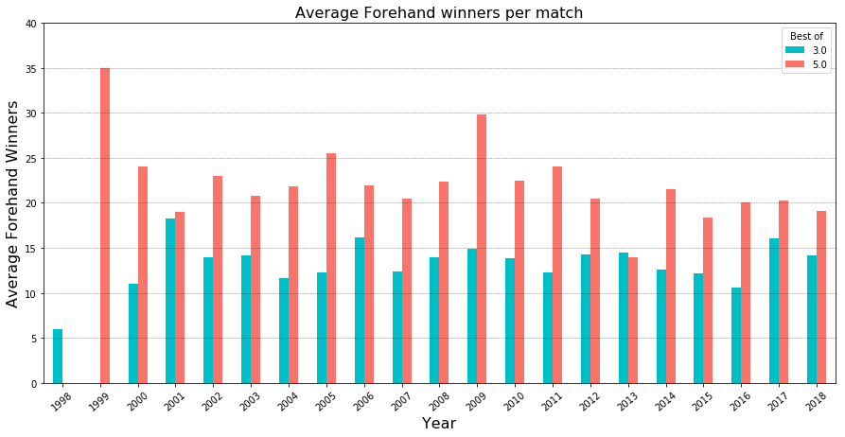
The Data: How did he do it?

Slide 10
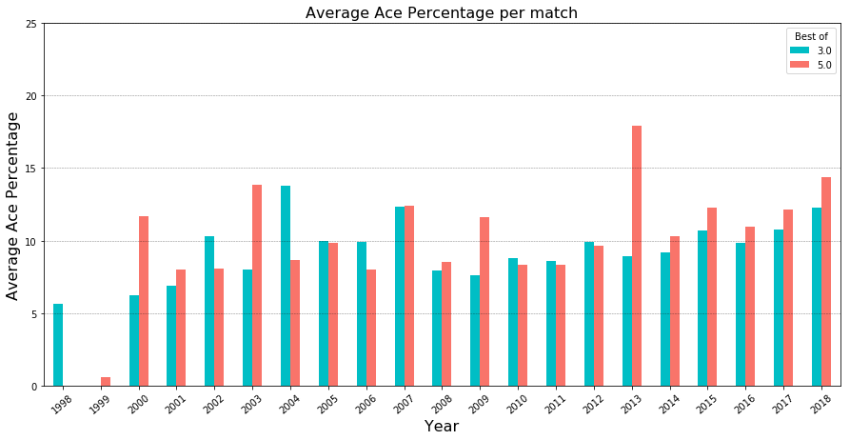
The Data: How did he do it?

